Slide 1
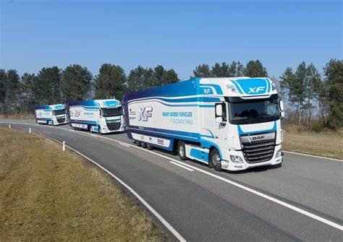
Truck platooning

Slide 2
A truck platoon consists of group of trucks moving together. One of the major motivations for truck platooning is that a truck moving behind another one, faces much reduced aerodynamic drag. This can account for significant fuel savings.
A truck platoon consists of group of trucks moving together. One of the major motivations for truck platooning is that a truck moving behind another one, faces much reduced aerodynamic drag. This can account for significant fuel savings (typically in range of 15-20 percent).

Slide 3
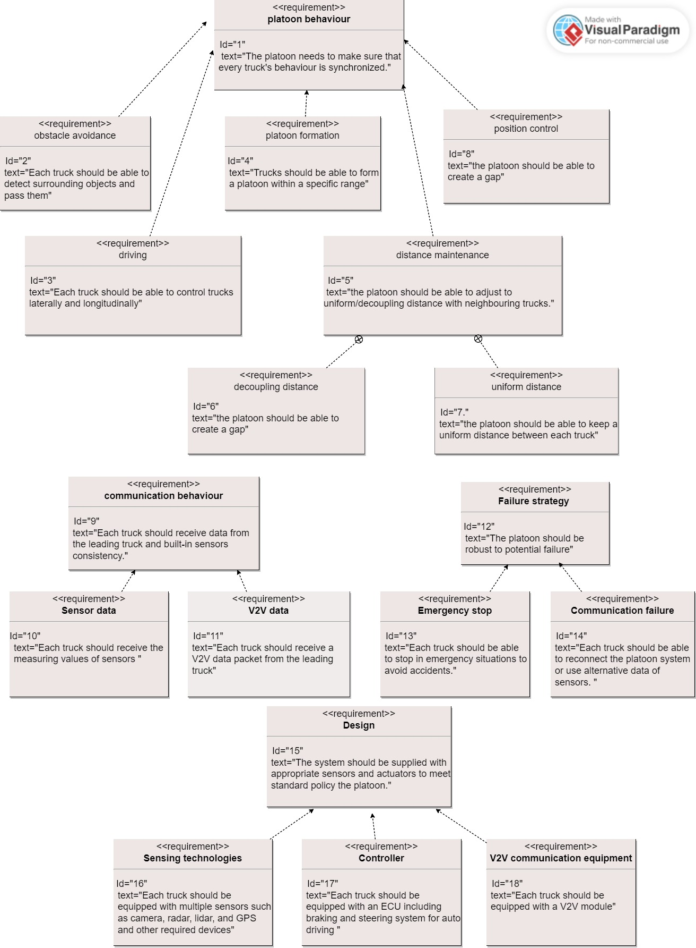
System Requirements

Slide 4
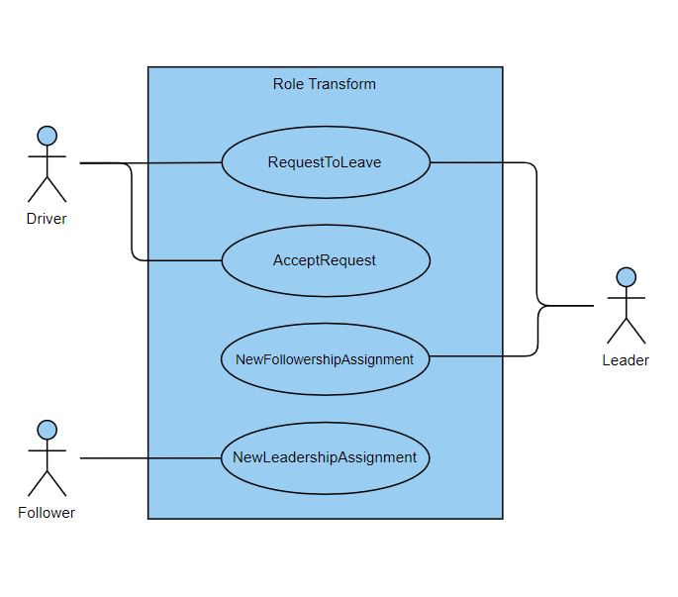
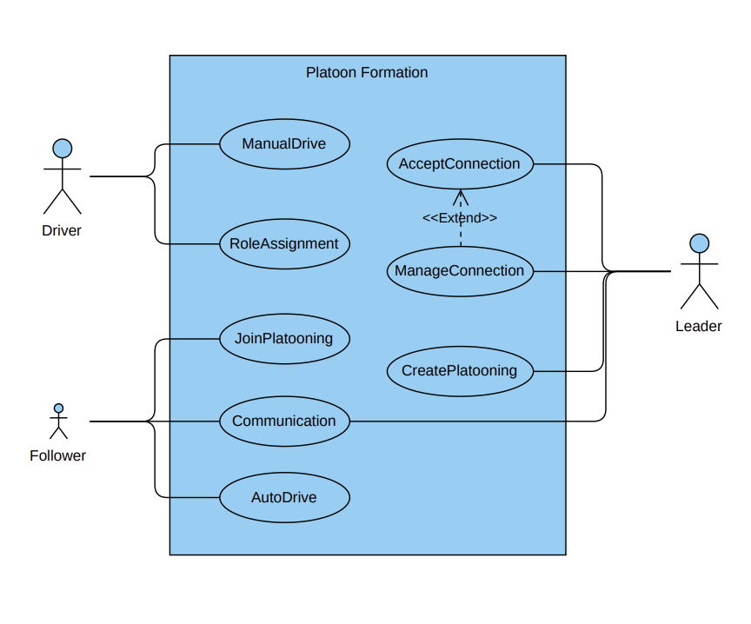
Use Case

Slide 5
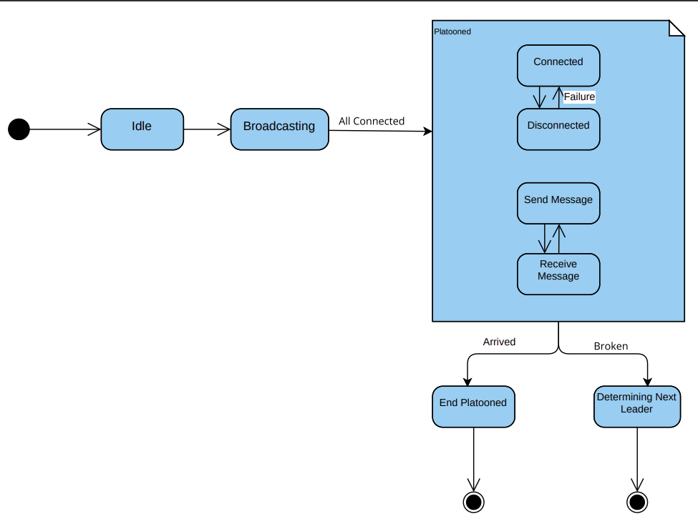
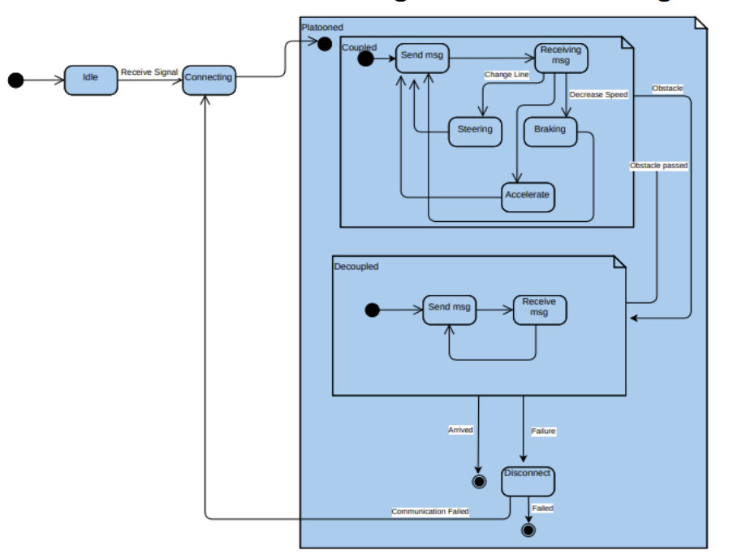
State Machine

Slide 6
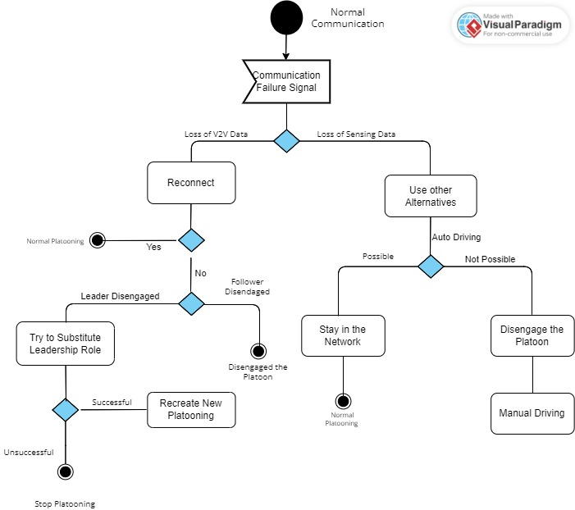
Activity Diagram

Slide 7
Implementation

Slide 8
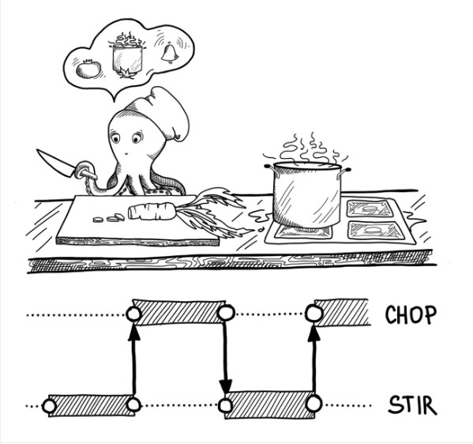
A. Concurrency and Parallelism
Our discussion in this section will focus on the way the platoon implements parallelism or concurrent.
However, let’s first briefly define these two concepts and the difference between them. Concurrency is about multiple tasks which start, run, and complete in overlapping time periods, in no specific order.
Imagine that one cook is chopping salad while occasionally stirring the soup on the stove. He has to stop chopping, check the stove top, and then start chopping again, and repeat this process until everything is done.
As you can see, we only have one processing resource here, the chef, and his concurrency is mostly related to logistics; without concurrency, the chef has to wait until the soup on the stove is ready to chop the salad.

Slide 9
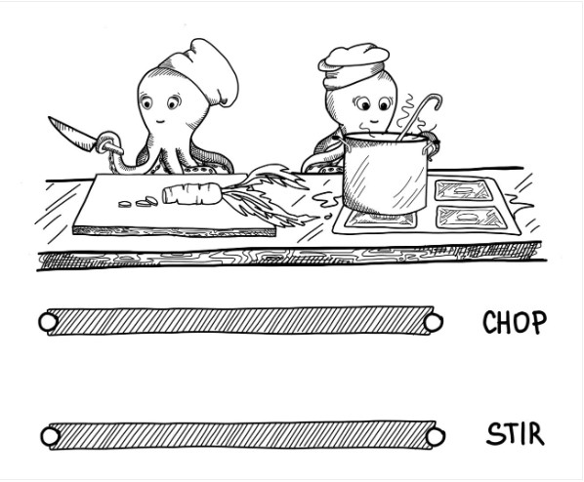
​
Parallelism is about multiple tasks or subtasks of the same task that literally run at the same time on a hardware with multiple computing resources like multi-core processor so that the task can be finished faster .​
Back in the kitchen, now we have two chefs, one who can do stirring and one who can chop the salad. We’ve divided the work by having another processing resource, another chef.
Parallelism is a subclass of concurrency: before you can do several tasks at once, you have to manage several tasks first.
As you can see, concurrency and parallelism are similar but not identical.

Slide 10
Let’s now discuss the implementation of concurrency and parallelism in the platoon case. ​
The follower trucks are driven autonomously, due to this they implement concurrency. A lot of concurrent tasks are running on each follower node to control its different driving parameters based on the current state of the leader truck. ​Each concurrent task is executed on a separate thread of execution. For example, there is the steering thread which is responsible for regularly adjusting the steering of the follower node according to the current position of the leader truck or the speed Control thread which is responsible for adjusting the speed of the follower node according to the current speed of the leader truck and try to keep the speed within a certain limit. Similarly with other threads like braking thread, ...etc.
We used OPENMP to implement parallelism in our platoon scenario.
Tasks that can be decomposed into independent subtasks are executed in parallel on separate threads to finish them faster. An OpenMP program has sections that are sequential and sections that are parallel. In general, an OpenMP program starts with a sequential section in which it sets up the environment, initializes the variables, and so on.
When run, an OpenMP program will use one thread (in the sequential sections), and several threads (in the parallel sections).
There is one thread that runs from the beginning to the end, and it's called the master thread. The parallel sections of the program will cause additional threads to fork. These are called the slave threads.

Slide 11
Our platoonin (in case of 4 trucks) is combined of 4 identical computing nodes. Each node has on its local physical memory a truck object that represents the controlled truck by this node .Each of the 4 nodes executes the same program.
But only some parts of the program will be executed on the node, depending on the role of each node is leader or follower. For example, a node, which is in the leader role, will execute only the threads that should be done by the leader such as connecting to the follower nodes, maintaining connection, ...etc. Whereas a node, which is in the follower role, will not execute these parts, but will execute threads that should be done by the followers such as the threads related to autonomous driving (speedControl thread, steering thread, braking thread, ...etc.).
These allows a high level of flexibility and role interchangeability between the different nodes of the platoon. If the leader node fails, any of the follower nodes can be changed to the leader role and then it can execute the parts of the program related to the leader.

Slide 12
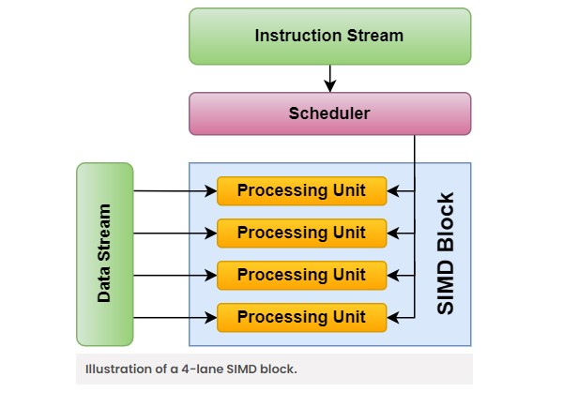
D. GPU Implementation
Each truck in the platoon has many sensors that detect and measure different parameters of the truck environment. We have to regularly read the measurements these sensors and store them in an array.
The classical way to perform this task is to implement a for loop to loop over these sensors and store their values, one after the other, is a Single Instruction Multiple Data (SIMD) task.
The main advantage of SIMD is that processing multiple data elements at the same time, with a single instruction, can dramatically improve performance. On the other hand There is complex communication between numbers of cores of processor. The cost is higher than SISD architecture.

Slide 13
A better implementation for this task is to use a GPU accelerator to accelerate the execution of this task by exploiting data parallelism. Each iteration of the for loop can be executed separately on one thread so that each thread will be handling​
one sensor. The kernel assigned to the GPU will describe the task that should be performed by each thread, which basically consists of two steps: reading the sensor value and storing it in the array of readings. ​
The host CPU has to launch the kernel, define the number of blocks in the GPU for executing that kernel, and define the​
number of threads per block. ​

